Slide 1
COMP3028 Software Architecture

Slide 2
Availability tactics

Slide 3
Recall our definitions of availability
Availability refers to a property of software that it is there and ready to carry out its task when you need it to be.

Slide 4
Recall our definitions of availability
Availability refers to a property of software that it is there and ready to carry out its task when you need it to be.
Can you think of any cases when this property of the system would not be satisfied?

Slide 5
Goal of Availability Tactics
Fault v.s. failure ?
A failure occurs when the system no longer delivers a service consistent with its specification
this failure is observable by the system’s actors.
A fault (or combination of faults) has the potential to cause a failure.

Slide 6
What will be the goal of availability tactics?

Slide 7
Recall our definitions of availability
Availability refers to a property of software that it is there and ready to carry out its task when you need it to be.
Availability is about minimizing service outage time by mitigating faults

Slide 8
Goal of Availability Tactics
Availability tactics enable a system to endure faults so that services remain compliant with their specifications.
The tactics keep faults from becoming failures
or at least bound the effects of the fault and make repair possible

Slide 9
Goal of Availability Tactics

Slide 10
Availability Tactics

Slide 11
Availability Tactics

Slide 12
Detect Faults
Ping/echo: used to determine reachability and the round-trip delay through the associated network path.

Slide 13
Detect Faults
Monitor: a component used to monitor the state of health of other parts of the system

Slide 14
Detect Faults: Heartbeat
Heartbeat: a periodic message exchange between a system monitor and a process being monitored.
The process periodically resets the watchdog timer in its monitor,
Piggybacking the heartbeat messages on to other control messages reduces the overhead
Difference between ping and heartbeat?
Who initiates the health check?

Slide 15
Detect Faults
Timestamp: used to detect incorrect sequences of events, primarily in distributed message-passing systems.

Slide 16
Detect Faults
Condition Monitoring: checking conditions in a process or device, or validating assumptions made during the design.
For example, checksum in data storage and transmission

Slide 17
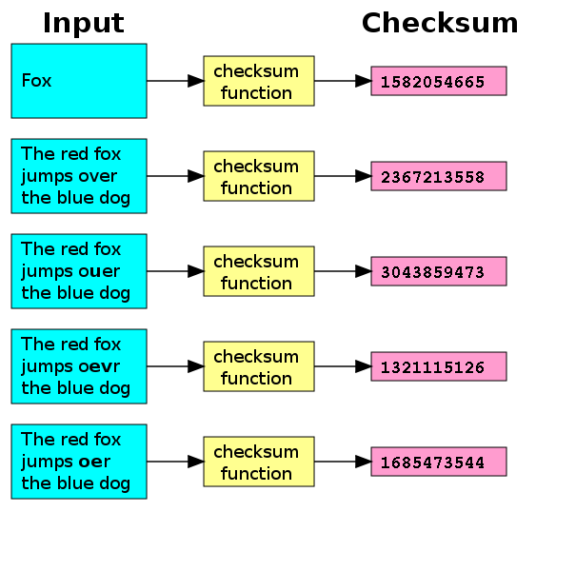
Checksum
Effect of a typical checksum function (the Unix cksum ) utility)

Slide 18
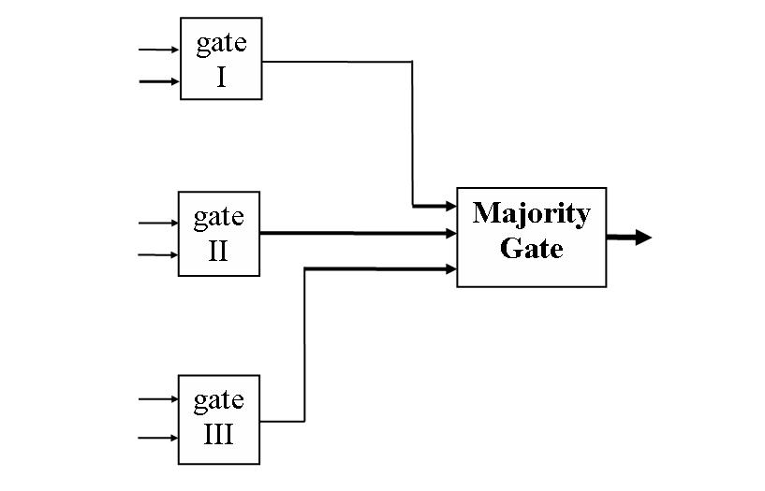
Detect Faults
Voting: the common realization of this tactic is Triple Modular Redundancy (TMR)
Voting component

Slide 19
Detect Faults
Exception Detection: detection of a system condition that alters the normal flow of execution, e.g. system exception, parameter typing, timeout.

Slide 20
Detect Faults
Self-test: procedure for a component to test itself for correct operation.

Slide 21
Availability Tactics

Slide 22
Recover from Faults (Preparation & Repair)
Active Redundancy (hot spare): all nodes in a protection group process identical inputs in parallel, allowing redundant spares to maintain synchronous state with the active nodes.

Slide 23
Recover from Faults (Preparation & Repair)
Spare (cold spare): redundant spares of a protection group remain out of service until a fail-over occurs, at which point a power-on-reset procedure is initiated on the redundant spare prior to its being placed in service.

Slide 24
Recover from Faults (Preparation & Repair)
Passive Redundancy (warm spare): only the active members of the protection group process input traffic;
one of their duties is to provide the redundant spare(s) with periodic state updates.
Notes:
VM

Slide 25
Recover from Faults (Preparation & Repair)
Rollback: revert to a previous known good state, referred to as the “rollback line”.
This tactic is combined with redundancy tactics
After a rollback has occurred, a standby version of the failed component becomes active
Rollback depends on a copy of a previous state (a checkpoint)
Checkpoint can be stored in a fixed location and needs to be updated regularly

Slide 26
Recover from Faults (Preparation & Repair)
Exception Handling: dealing with the exception by reporting it or handling it, potentially masking the fault by correcting the cause of the exception and retrying.

Slide 27
Recover from Faults (Preparation & Repair)
Retry: where a failure is transient and retrying the operation may lead to success.
For example, network re-transmission

Slide 28
Recover from Faults (Preparation & Repair)
Ignore Faulty Behavior: ignoring messages sent from a source when it is determined that those messages are spurious.
E.g., ignore the messages from a denial of service attacker

Slide 29
Recover from Faults (Preparation & Repair)
Degradation: maintains the most critical system functions in the presence of component failures, dropping less critical functions.

Slide 30
Recover from Faults (Preparation & Repair)
Reconfiguration: reassigning responsibilities to the resources left functioning, while maintaining as much functionality as possible.

Slide 31
Availability Tactics

Slide 32
Prevent Faults
Removal From Service: temporarily placing a system component in an out-of-service state for the purpose of mitigating potential system failures

Slide 33
Prevent Faults
Transactions: bundling state updates so that asynchronous messages exchanged between distributed components are atomic, consistent, isolated, and durable.

Slide 34
Prevent Faults
Predictive Model: take corrective action when conditions are detected that are predictive of likely future faults.

Slide 35
Prevent Faults
Exception Prevention: preventing system exceptions from occurring by preventing it via smart pointers, abstract data types, wrappers.

Slide 36
Prevent Faults
Increase Competence Set: designing a component to handle more cases—faults—as part of its normal operation

Slide 37
Summary
Availability refers to the ability of the system to be available for use when a fault occurs.
The fault must be recognized (or prevented) and then the system must respond.
The response will depend on the criticality of the application and the type of fault
can range from “ignore it” to “keep on going as if it didn’t occur.”

Slide 38
Summary
Tactics for availability are categorized into detect faults, recover from faults and prevent faults.
Detection tactics depend on detecting signs of life from various components.
Recovery tactics are retrying an operation or maintaining redundant data or computations.
Prevention tactics depend on removing elements from service or limiting the scope of faults.

